Slide 1

OPTIMIZING ASTROGURU'S CALL CENTER PERFORMANCE
Data-Driven Strategies for Efficiency & Customer Satisfaction
Presented By – Parakh Sheth

Slide 2

INTRODUCTION
This project focuses on improving AstroGuru's call center operations by enhancing efficiency and customer satisfaction. By analyzing consultation patterns, agent performance, and user feedback, we aim to identify key areas for improvement—whether through better training, smarter technology, or optimized workload distribution. The goal is to create a seamless experience for both users and astrologers, ensuring faster resolutions, higher satisfaction, and sustainable growth.
In essence: "This project aims to optimize AstroGuru's call center by streamlining consultations, improving agent performance, and leveraging technology to boost customer satisfaction and operational efficiency."

Slide 3
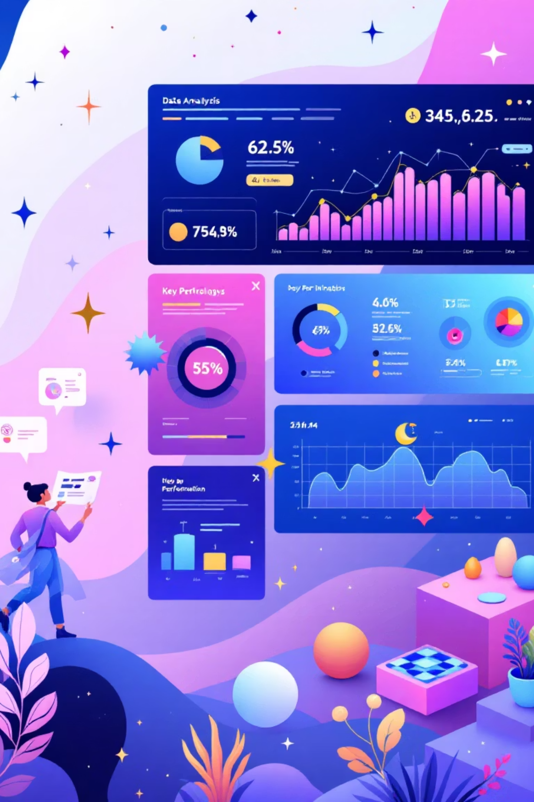

PROJECT OBJECTIVES
Monitor Consultant Performance
To track and evaluate individual consultant effectiveness based on success rates, ratings, and revenue contribution.
Improve Customer Satisfaction
To identify factors affecting user experience and enhance service quality through better support and optimized consultation methods.
Optimize Operation Efficiency
To analyze peak hours, consultation type, and failure patterns for better resource allocation and service planning.
Support Data-Driven Decisions
To provide actionable insights that guide strategic investments in hiring, training, and technology upgrades.

Slide 4

PROBLEM STATEMENT
Performance Analysis
Analyze consultant performance based on revenue generation and success rates.
Identify top-performing consultants who exceed the average revenue per consultation.
Quality Improvement: Addressing Low Ratings
On a 10-point scale, anything below 5.0 is considered unsatisfactory.
Operational Efficiency
An average rating of 2.93/10 falls into the "very poor" category, indicating widespread customer dissatisfaction and a critical need for intervention.
Correlate Total Gurus (149) and Total Visitors (28,027) with revenue to measure marketing and operational efficiency.
Revenue Optimization
Analyze the consult success rate (43.53%) to identify bottlenecks in the consultation process.
Segment revenue by consultant type to identify most profitable services.
Calculate the 20% of consultants generating 80% of revenue (Pareto Principle).
Calls dominate revenue (70% share) but have lower revenue per session compared to chats.
Data Visualization
Create a dashboard that better presents the revenue distribution across consultants.
Low ratings correlate with high churn. Your 43.53% consult success rate could drop further, impacting future revenue.
Develop visualizations to show trends in ratings, revenue, and consultation types over time.

Slide 5

EXECUTION MAP
01
02
Data Gathering
Data Refinement
Collect raw data from all relevant sources, including CRM, call logs, and feedback systems.
Cleanse, preprocess, and structure the data for accurate analysis. Handle missing values and inconsistencies.
03
04
Initial Data Exploration
Dashboard Creation
Perform exploratory data analysis (EDA) to uncover initial patterns, anomalies, and relationships within the data.
Design and build interactive dashboards to visualize key metrics, trends, and performance indicators.
05
06
Insight Extraction
Strategic Takeaways
Utilize statistical analysis and data mining techniques to extract deep insights and identify root causes of issues.
Formulate actionable recommendations and strategic implications based on the extracted insights.

Slide 6

FROM DATA TO DISCOVERY
A low overall consultation success rate points to systemic issues in process or agent capability.
Calls generate significantly higher revenue than chats, indicating a need to prioritize and optimize the call channel.
Chat failure rate is higher than call failure rate, suggesting deficiencies in chat support or user expectations in that channel.
Gurucool has more users than the app, yet Gurucool handles more consultations but also more failures, highlighting scalability or support issues on that platform.
The morning shift sees the highest failure volume and peak call activity, indicating a potential resource or training gap during this critical period.
Average user ratings are low across both platforms, emphasizing a pervasive customer satisfaction problem.
A few top gurus contribute a major share of total revenue; specifically, the Top 6 gurus are responsible for a major portion of the revenue, suggesting a heavy reliance on a small subset of high-performing consultants. This insight supports strategic investments in retaining and replicating the success of these top performers.

Slide 7
CALL AND CHAT PROGRESS
Call Progress:
Success Rate: 41% - Less than half of calls are completed successfully
Critical Issue: 35% combined failure rate (15% failed + 20% no-answer) indicates serious operational challenges requiring immediate intervention
Chat Progress:
Success Rate: 34% - Lower completion rate compared to calls
Major Concern: 66% failure rate (37% failed + 29% pending) suggests system breakdown and urgent need for chat infrastructure improvement

Slide 8
RATING-WISE GURU DISTRIBUTION
Alarming Quality Crisis: 65% Gurus Below Average (0-2 Stars)
14,584 gurus with poor ratings creating negative customer experience
Immediate intervention required to prevent platform reputation damage
Massive Untapped Potential: 6,538 Mid-Range Gurus (29%)
Rating 3-4 performers can be converted to excellence with proper training
Strategic focus area for quick ROI improvement
Elite Talent Shortage: Only 6% High Performers (5-8 Stars)
Premium segment severely under-resourced with just 1,378 top-rated gurus
Competitive disadvantage in attracting quality-seeking customers
Revenue Impact: Low-Quality Dominance Threatens Business Growth
Customer retention at risk due to poor service quality distribution
Premium pricing strategy unsustainable with current guru quality mix
Operational Urgency: 94% Gurus Need Quality Improvement
Only 1,378 out of 22,500 gurus meet excellence standards
Systematic quality enhancement program essential for business survival
Market Positioning Crisis: Quality Distribution Below Industry Standards
Current rating distribution indicates operational inefficiency
Competitor advantage due to superior guru quality management

Slide 9
REVENUE BY CONSULTATION TYPE
Call Dominance: ₹1,77,892 (79% of Total Revenue)
Calls generate maximum revenue - core business driver
4x higher revenue than chat consultations
Chat Revenue Potential: ₹45,495 (20% Share)
Strong secondary revenue stream with growth opportunity
Digital channel showing significant monetary contribution
Complementary Services Underperforming: ₹51 Combined
Public live calls, compensatory, and other services contribute minimal revenue
Untapped potential in specialized consultation formats
Revenue Concentration Risk: 99% Dependency on Call + Chat
Over-reliance on two channels creates business vulnerability
Diversification needed to reduce revenue concentration risk
Digital Transformation Opportunity: Chat Scaling Potential
Chat already contributing ₹45K+ revenue demonstrates customer acceptance
Strategic focus on chat optimization could unlock significant revenue growth
Service Mix Optimization Required: Underutilized Channel Revenue
Public live calls and compensatory services showing poor monetization
Product development needed to enhance low-performing revenue streams

Slide 10
WEBSITE DISTRIBUTION
GuruCool Website Dominance: 20,225 Users (72%)
Main platform drives majority of user engagement
Strong web-based customer preference indicates desktop/laptop usage
Mobile App Performance: 7,800 Users (28%)
Significant mobile user base shows growing digital adoption
One-third of users prefer mobile convenience for consultations
Digital Channel Balance: 72% Web vs 28% Mobile
Healthy distribution across platforms reduces single-point dependency
Multi-channel strategy successfully capturing diverse user preferences
Strategic Implication: Cross-Platform Optimization Required
Web platform excellence critical for maintaining 72% user base
Mobile app enhancement opportunity to capture additional market share
User Behavior Insight: Desktop Preference for Consultations
20K+ users choosing web suggests preference for larger screens
Indicates consultation complexity requiring detailed interface interaction
Growth Opportunity: Mobile App Conversion Potential
7,800 mobile users demonstrate smartphone consultation viability
App feature enhancement could shift more users from web to mobile

Slide 11
TOP 10 GURU PERFORMANCE ANALYSIS
Elite Performer Identification: 7.5+ Rating Threshold
Only 2 gurus (Astro Pujaa Rai & Tarot Mystical) achieve premium 7.5+ ratings
20% of top performers drive exceptional customer satisfaction
Mid-Tier Dominance: 5.0-6.0 Rating Cluster
70% of gurus clustered in 5.0-6.0 performance band
Astro Saraswat, Trisha, Manish S, Reema, Daljit, Ankita show consistent mid-range delivery
Service Specialization Impact: Astrology vs Tarot Performance
Astrology specialists show wider rating variance (5.0-7.5 range)
Tarot practitioners demonstrate more consistent performance clustering
Performance Consistency Risk: Rating Volatility Concern
Significant 2.5-point spread between highest (7.5) and lowest (5.0) performers
40% performance gap between top and bottom-tier gurus creates service quality inconsistency
Quality Optimization Opportunity: Bottom-Tier Improvement Potential
3 gurus (Astro Manish S, Tarot Diya Poonam, Tarot Oormika) underperforming at 5.0-5.5
30% of top-rated gurus operating below optimal satisfaction levels
Rating Median Analysis: 5.6 Platform Average Concern
Overall platform rating of 5.6 indicates moderate customer satisfaction levels
50% of gurus performing below 5.8 threshold suggests systematic quality issues
Premium Service Gap: Revenue Opportunity Loss
Only 20% of gurus qualify for premium pricing (7.0+ ratings)
High-quality service shortage limits revenue maximization potential

Slide 12
TOP 10 GURU BASED ON NO. OF CONSULTATIONS
Star Performer: Astro Krishaa (1,580 Consultations)
Platform's top consultant with 15% higher performance than #2
Exceptional customer demand demonstrates superior service quality
High-Volume Leaders: Top 3 Drive 4,351 Consultations (40%)
Astro Krishaa, Astro Sakthi, and Astro Shalini dominate consultation volume
Elite trio handling significant portion of premium customer base
Performance Gap Analysis: 837-Consultation Average Difference
Wide performance variance between top (1,580) and bottom (743) performers
Indicates significant skill/popularity disparity among top-tier gurus
Astrology Specialization Dominance: 80% Market Share
8 out of 10 top performers are astrology specialists
Clear customer preference for astrological consultation services
Tarot Niche Performance: 1,743 Combined Consultations
Tarot Gurpreet and Tarot Bee Riya show strong specialized market demand
Demonstrates viable revenue stream in alternative consultation categories
Strategic Insight: Star System Creates Revenue Concentration
Top 10 gurus likely generating disproportionate platform revenue
Heavy dependence on key performers creates business continuity risk

Slide 13
AVERAGE NO. OF CALL VS EACH HOUR RANGE
Prime Morning Rush: 6-8 AM (5,397 Calls - Peak Volume)
Highest customer activity during early morning hours
Early risers seeking guidance before daily routines begin
Business Hours Excellence: 9-11 AM & 12-2 PM (4,843 Each)
Consistent high-volume periods during professional working hours
Strategic staffing required during dual peak morning/afternoon slots
Evening Prime Time: 3-5 PM (4,968 Calls - Second Peak)
Strong after-work consultation demand
Post-office hours creating significant revenue opportunity
Off-Peak Performance: Night Hours Show 83% Drop
9-11 PM (882 calls) and 12-2 AM (1,078 calls) minimal activity
Clear customer preference for daytime consultations
Early Morning Moderate Activity: 3-5 AM (3,441 Calls)
Surprising pre-dawn consultation volume
Indicates diverse customer sleep patterns and urgent consultation needs
Strategic Staffing Insight: 4 Major Peak Windows Identified
70% of daily call volume concentrated in 6-8 AM, 9-11 AM, 12-2 PM, 3-5 PM
Resource optimization opportunity during low-traffic evening/night hours

Slide 14
DAILY NO. OF CONSULTATION TYPE
December Peak Performance: 1,325 Consultations (Peak Month)
Highest customer demand during year-end period
Holiday season drives maximum consultation activity
Consistent High Volume: November-February Maintains 1000+ Daily
Winter months show sustained customer engagement
4-month peak period generates core business revenue
Mid-Year Stability: March-October Averages 800-900 Daily
Steady baseline performance during regular months
Consistent customer retention throughout standard periods
Summer Dip Pattern: June-August Shows 20% Decline
Seasonal consultation reduction during vacation months
Expected customer behavior shift during summer period
Year-End Recovery: Strong November-December Surge
56% increase from October (774) to December (1,325)
Festival and new year planning drives consultation spike
Business Seasonality: Clear Winter Peak Strategy Required
40% higher consultation volume during Q4/Q1 months
Resource allocation and marketing focus needed for seasonal optimization

Slide 15
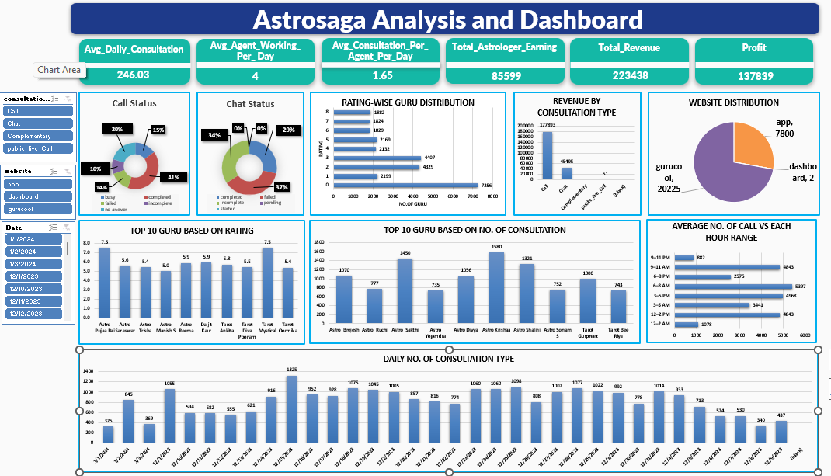

Slide 16

CONCLUSION
The dashboard indicates a high volume of user engagement, with a significant number of visitors and consultations, reflecting strong platform activity.
Revenue distribution shows a preference for chat-based consultations over calls, suggesting users may find chat interactions more convenient or accessible.
Peak activity occurs during specific time slots, highlighting the importance of scheduling resources to handle high demand periods effectively.
Chat success rates are notably higher than call success rates, indicating that chat-based services might be more reliable or preferred by users.
A considerable number of consultations fail, pointing to potential areas for improvement in service delivery or user experience to reduce failure rates.

Slide 17

RECOMMENDATION
Enhance Consultant Training
Provide regular skill development sessions to improve consultation quality and boost overall success rates.
Optimize Consultant Scheduling
Align consultant availability with peak user activity hours to ensure better engagement and reduced wait times.
Monitor Consultant Performance
Identify consistently underperforming consultants and provide support or intervention to improve user satisfaction.
Promote Top Performers
Highlight and reward consultants with high success rates and positive user feedback to encourage quality service.
Balance Staffing on Weekdays and Weekends
Ensure consultant availability matches user demand patterns throughout the week.
Focus on User Feedback
Actively collect and analyze user reviews to understand service gaps and improve overall experience.

Slide 18


